Slide 1
Votes & Voices: Using Data Science to Uncover Voter Turnout Disparities
Tanvi Chennuru & Cole Whittington
CDS Data Science Capstone
Notes:
Things to add:
Maybe a diagram of our hierarchy (pm, tpm, client, etc)
Results

Slide 2

Client & Project
Mission: Enable adults in Eastern MA to overcome racial, social, and economic barriers, in order to access employment and economic development opportunities
Low Propensity: individuals who are eligible to vote but have a history of infrequent participation in elections.
Project Description: The goal of this project is to track and utilize voter turnout data to assist efforts in increasing voter turnout in upcoming elections at the local level, specifically in low-propensity areas.
Deliverable: An interactive dashboard to visualize voters at the precinct level to understand who these low propensity voters (i.e. income level, race/ethnicity, neighborhood)
Notes:
Add chelsea

Slide 3
Background & Importance
Low voter turnout (<15%) for municipal elections are due to barriers to voting
Most voters in municipal elections are white, affluent, and/or elder individuals
Why?
Taking time off of work
Lack of knowledge about the election
Belief that there is little impact on individual’s lives
Chelsea, MA
Within Eastern Massachusetts, Chelsea has a low-voter turnout within municipal elections compared to surrounding cities, and we want to know why!
Notes:
Lower voter turnout for municipal elections because?
Demographics & voting
Barriers to voting historically: getting off work, lack of knowledge
By increasing voter turnout in Chelsea, more voices can be heard/involved in political process
Why? Taking time off of work, lack of knowledge about the election, belief that there is little impact on individual’s lives.

Slide 4
Elections
Federal
President, Senators, Representatives
State
Governor, State Senators, State Representatives
Municipal
Mayor, City Council Members, School Board Officials, Sheriffs, etc.
You!!!!
Belief that there is little impact on individual’s lives
Notes:
Why municipal?
Municipal elections have lower turnout rates even though local elections matter the mo

Slide 5
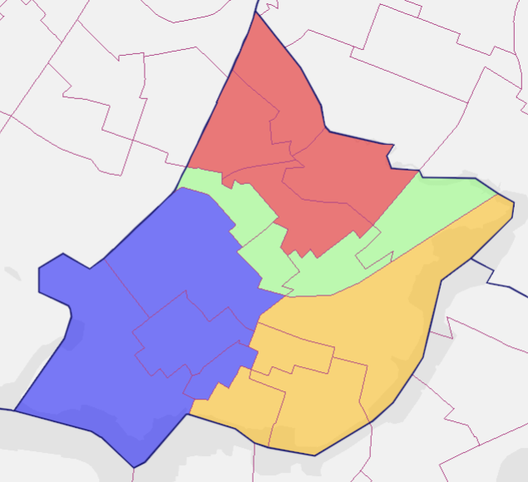
Context
Ward
Precinct
Ward: a geographic area of a city, typically made up of multiple precincts
Election Data
Precinct: a geographic area within a ward that determines where people go to vote and what appears on their ballot
Census tract: small, relatively permanent subdivision of a county used by the U.S. Census Bureau to collect and analyze population data
Population Data
Notes:
Census tract vs precinct vs wards
Census tract: small, relatively permanent subdivision of a county used by the U.S. Census Bureau to collect and analyze population data.
Purpose: Analyzing demographic and economic data, Planning community services and development, Identifying areas for federal or state funding (like opportunity zones, low-income areas, etc.)
Precinct: geographic area that determines where people go to vote and what appears on their ballot. (which candidates or ballot questions they're eligible to vote on)
Purpose: helps ensure ballots are tailored to where voters live.
Ward: A ward is a geographic area of a city, typically made up of multiple precincts.
Purpose: It's used to organize local elections, especially for city council representation.

Slide 6
Datasets
Voter Turnout Data:
Street address
Political affiliation
Voter ID number
Ward number
Precinct number
Census tract
Date of birth
Date of registration
Census Data:
Race/Ethnicity proportions
Income distribution

Slide 7






Tools
Data Collection
Data Storage
Project Management
Data Analysis
Data Visualization
Notes:
BigQuery
API to get census tract
Voter data provided by SPARK through City of Chelsea
Python for data manipulation and cleaning
Tableau for dashboard
Notion

Slide 8
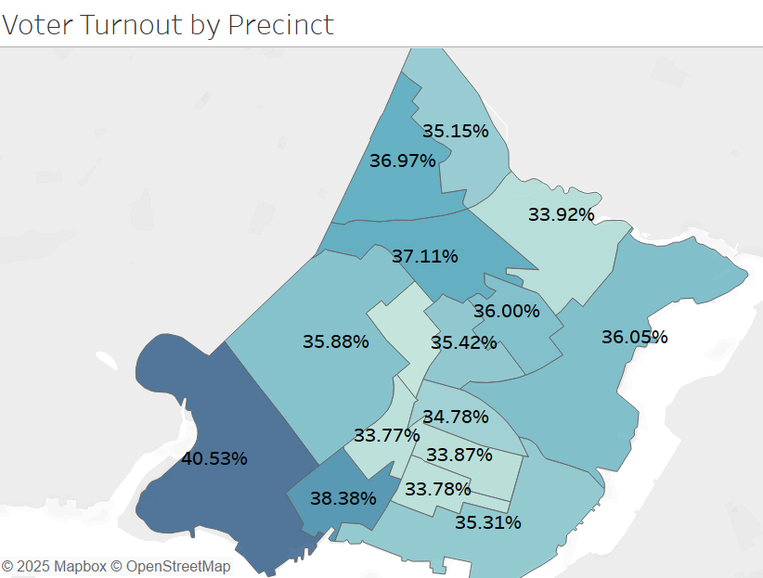
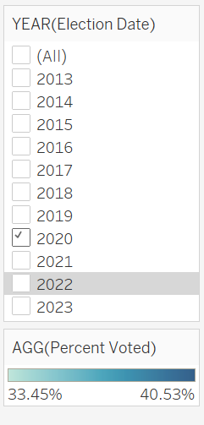
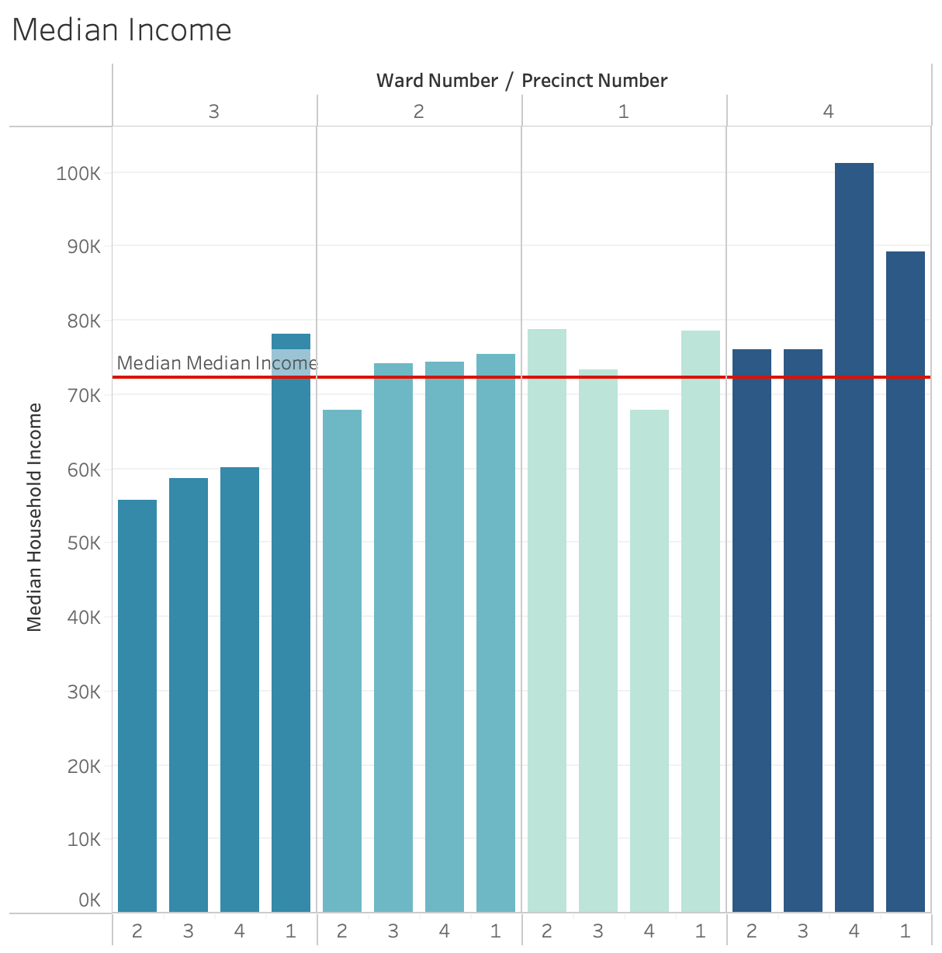
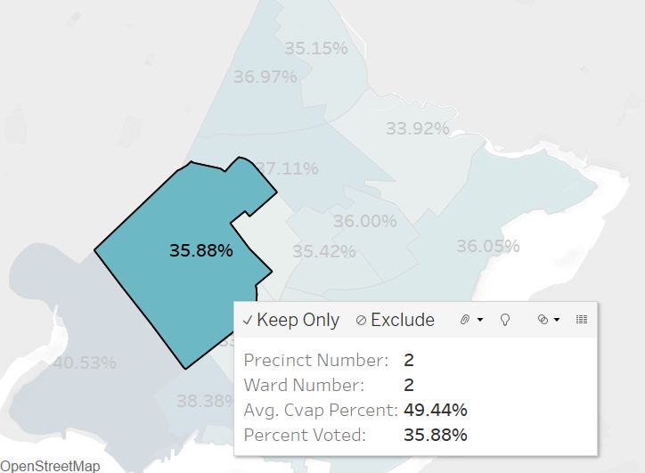
Results
Notes:
Dashboard
What does it show?
What did we learn?

Slide 9
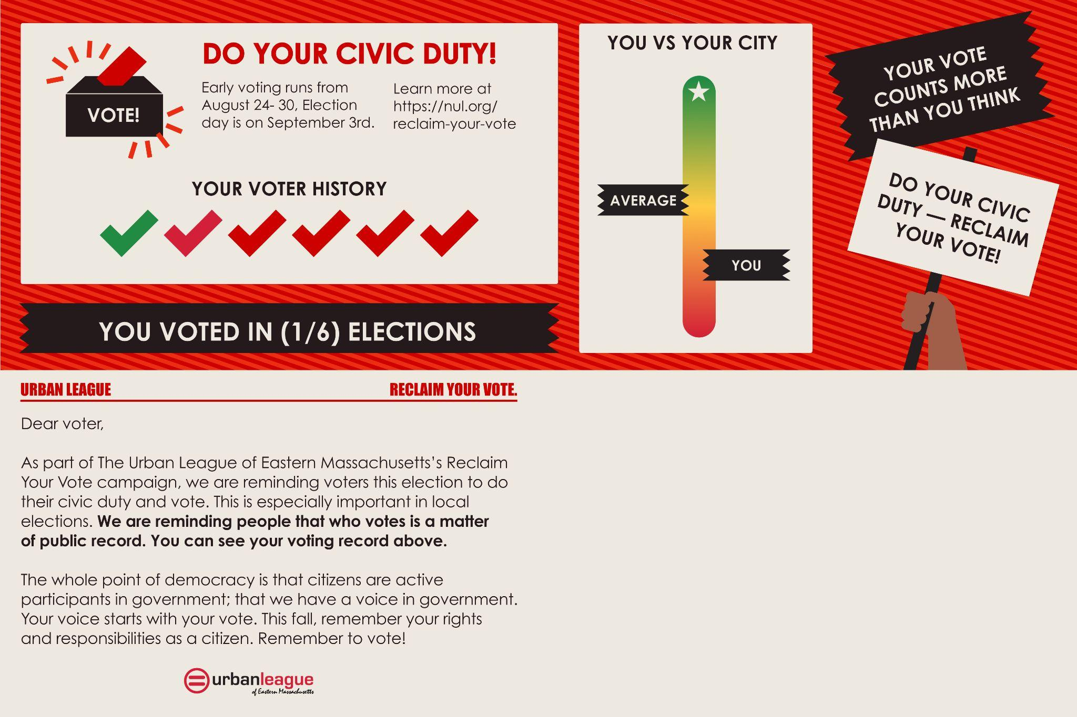
Impact & Next Steps
Deliverable: An interactive dashboard to visualize voters at the precinct level to understand who these low propensity voters (i.e. income level, race/ethnicity, neighborhood)
INCREASE VOTER PARTICIPATION IN MUNICIPAL ELECTIONS!!
Impact:
Supports outreach planning
Eases accessibility for non-experts
Guides resource allocation
Outcomes:
Increased awareness of voting eligibility and access in underrepresented communities
Improved outreach efficiency and engagement strategy through data
Framework for measuring voter turnout shifts in targeted areas
Notes:
Supports outreach planning: enables stakeholders to prioritize neighborhoods and demographics for flier distribution
Visualized impact zones: interactive maps allow for real-time filtering based on age, income, education, and past voting history
Guides resource allocation: helps determine where to focus limited outreach budgers for maximum impact

Slide 10
Thank you!
Notes:
Dashboard
What does it show?
What did we learn?

